Slide 1

Office Performance Evaluation
TEAM N
Shama Praveen
C3470623

Slide 2
Executive Summary
Objective: Evaluate the performance level of office and seek some of the places that may be closed or scaled down.
Key Metrics: Compliance rate, community feedback, equipment usage, incentive distribution.
Outcome: Identified list of offices that need downsizing or consolidation recommendations.

Slide 3
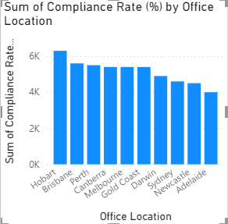
Ranking of Offices by Key Performance Metrics
Highest Compliance Rates
Hobart: This was the highest in the category of compliance with total score of 2,020.75% for respondent’s compliance to company policies.
Canberra & Gold Coast: High overall compliance at 1,636.36% and 1,630.19% with respect to law compliance.
Mid-Level Compliance Rates
Perth: Moderate compliance at 1452.83%.
Sydney & Brisbane: Moderate level of compliance of 1,272.34% and 1,200.00% at lower level.
Lowest Compliance Rates
Adelaide: The lowest value occurred at 818.18%, showing that there is a severe problem with non- compliance.
Melbourne & Newcastle: Also comparatively low at 1, 005.88% and 1, 058.82% to recommend improvement.

Slide 4
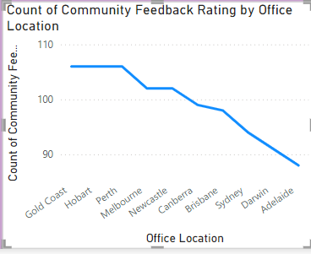
Community Feedback Insights
Top-Rated Locations:
Gold Coast (110) and Hobart show strong community approval, likely due to effective service and community engagement.
Mid-Rated Locations:
Perth, Melbourne, Newcastle demonstrate moderate community satisfaction.
Low-Rated Locations:
Brisbane, Sydney, Darwin, Adelaide have lower feedback, with Adelaide scoring the lowest (<90), indicating potential issues in customer service or community relations.

Slide 5
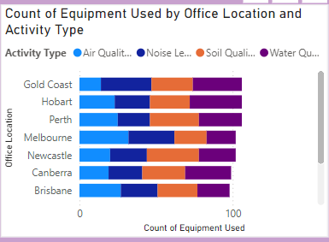
Air Quality Check: High in Melbourne (32), Sydney (27), and Darwin (29) – likely due to urban pollution.
Noise Level Measurement: Highest in Gold Coast (33) and Melbourne (30) – possibly driven by industrial noise concerns.
Soil Quality Test: Highest in Newcastle (34) and Perth (32) – likely due to agricultural soil health monitoring.
Water Quality Test: Top scores in Hobart (34) and Gold Coast (32) – indicating water quality is a major environmental focus.

Slide 6
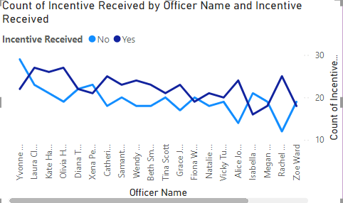
Incentive Program
Some of officers include Yvonne Cook and Laura Clark post higher “No”, meaning that they are less often motivated by incentives.
Grace Jones and Rachel King seem to have a higher number count in “Yes” meaning they are being recognized more often.
Insight
Need for Standardized Criteria: Such differences imply that incentive awards probably have not been established on an equivalent basis. Clear and definite standards can be utilized to avoid unmerited or unwarranted bonus given to employees so as to enhance the measures of uniformity and stimulus.

Slide 7

Offices Recommended for Downsizing or Closure
Low-Performing Offices
Adelaide: Lowest in compliance and community feedback; should be closed or downsized.
Darwin: Marginal performance; risk of cutbacks or merger.
Melbourne: Performance fairly satisfactory; recommendation for further decrease in resource use.

Slide 8

Retention Recommendations with Focus Areas for Improvement
Brisbane and Sydney: Keep with emphasis on communication with communities and organizational conformity enhancement.
Newcastle: Retain as after all equipment do specializes in certain extent but at the same time with the focus on compliance improvement.

Slide 9
High-Performing Offices to Retain
Top Offices:
Hobart, Canberra, Gold Coast: Compliance and community feedback and efficient usage of resources.
Action: Current activities; identify new pattern that could be used in other offices

Slide 10
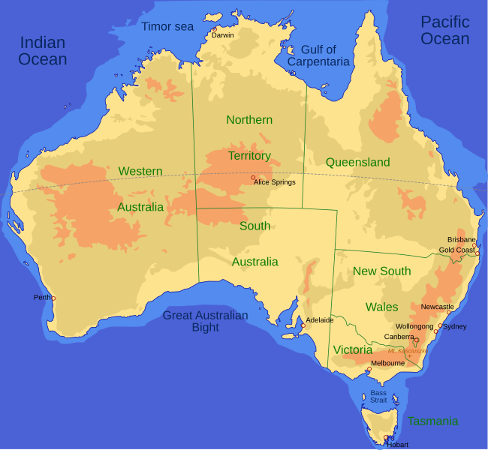
Summary
Downsize or Close: Adelaide, Darwin,
Melbourne
Retain with Improvement Focus: Brisbane,
Sydney, Newcastle
Maintain Current Levels: Hobart, Canberra, Gold Coast
Resource Optimization: Enhance resource allocation and consider regional specializations.

